Slide 1


Business Understanding Of Cohort Analysis Report For Customer Retention
Analysis for Trend ,behavior and understanding Business challenges

Slide 2
Tools & Technologies Used
Python – main programming language.
Pandas – for data manipulation and analysis.
NumPy – for numerical computations.
Matplotlib / Seaborn – for plotting and visualization.
scikit-learn (sklearn) – for clustering (KMeans) .
Yellowbrick – for visualizing clustering performance and model insights.
Jupyter Notebook – development environment.
I Used Python with scikit-learn for KMeans clustering and Yellowbrick for visual insights to segment customers. Leveraged Pandas and NumPy for data prep, and Matplotlib/Seaborn for visualization. Insights guided strategies to retain VIPs, nurture high-potential customers, and re-engage at-risk segments for higher Return on Investment.

Slide 3
Business Understanding
The company aims to understand customer purchasing behavior over time for improved retention, marketing, and revenue initiatives. Cohort analysis allows one to track how sets of customers (cohorts) behave from the moment of first purchase onwards.
Business Problem: Customers often leave after their initial purchases, causing missed opportunities for sustained revenue growth.
Objective: Identify customer cohort retention patterns and revenue contributions to drive long-term engagement initiatives.

Slide 4
Key Features of the Analysis
Transactions: Includes invoices, product categories, and prices.
Columns Used: InvoiceDate, CustomerID, Revenue, InvoiceMonth, cohortMonth, cohortIndex.
Cohorts: Customers that are divided into groups depending on the first purchase month (cohortMonth).
Cohort Index: Months elapsed since the first purchase.

Slide 5
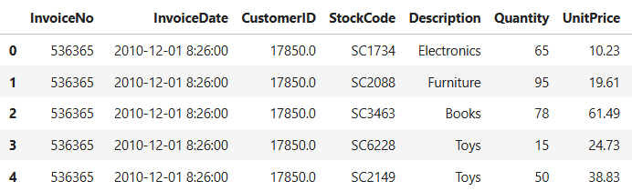
Dataset Overview
The E-commerce dataset contains 541,909 entries with 8 columns, including InvoiceDate, StockCode, Quantity, UnitPrice, CustomerId, and Country, representing the locations of all purchases.
Some CustomerId values were null, which were dropped to allow tracking of transactions for each customer.
We also check if there are any negative values in Quantity and unitPrice columns

Slide 6
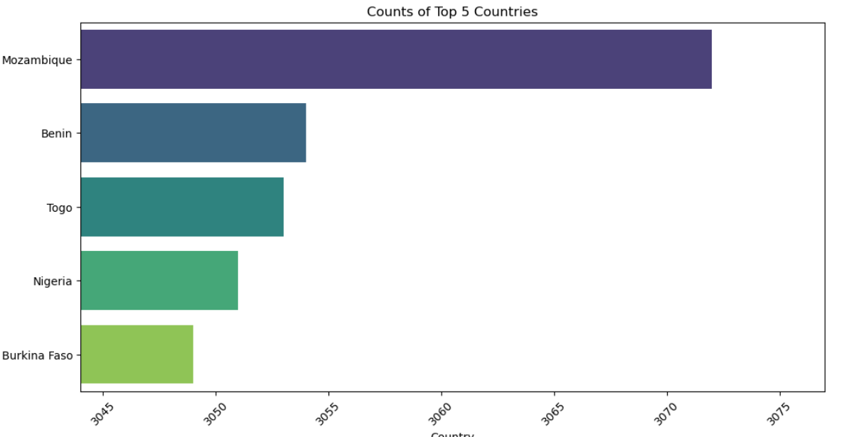
Visualization Summary
The top five countries with the highest number of purchases are Mozambique (3,072), Benin (3,053), Togo (3,053), Nigeria (3,051), and Burkina Faso (3,049). The range of purchases among these five countries shows low variance, with a standard deviation of 8.

Slide 7
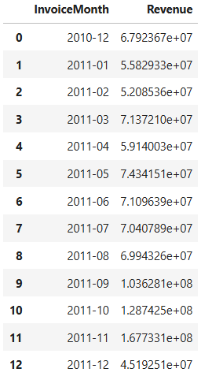
Data Transformation
We generated a Revenue column by multiplying Quantity by UnitPrice in order to calculate the revenue. This allows us to use the InvoiceMonth column to group and analyze the revenue generated per month according to the dataset.

Slide 8
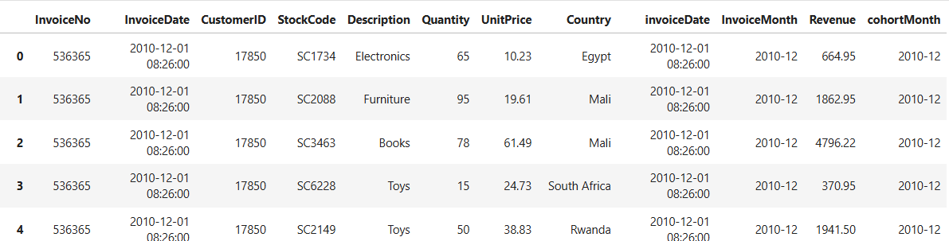
We also created a variable named cohort_data by grouping CustomerID by InvoiceMonth. We then renamed CohortDate to CohortMonth and merged it with our dataset to enable more meaningful analysis.

Slide 9
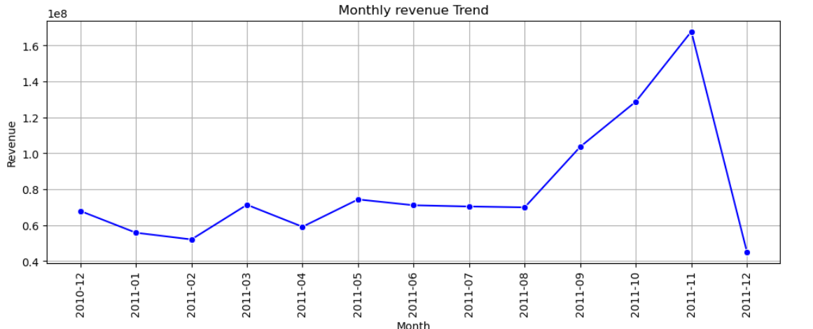
Monthly Revenue Performance Analysis
Revenue peaked in the first purchase month, then dropped significantly ,Between the 2nd and 3rd months, and fluctuating from the 3rd to 7th months, count remained relatively flat, indicating low activity during this period. However, in the 8th month, count peaked again, showing strong sales. By the 12th month, count dropped drastically. These insights suggest that the company performed poorly in the first and second quarters of the year.

Slide 10
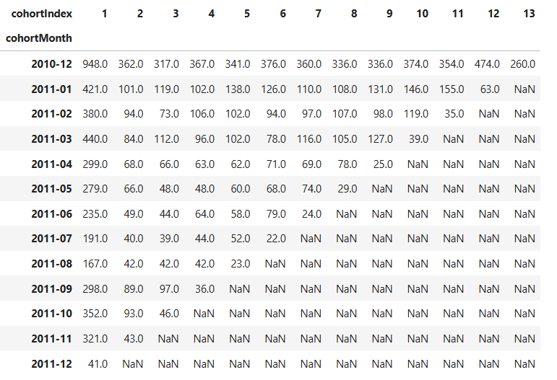
Insights from Cohort Revenue Data
The first month cohortIndex 1 has the maximum revenue for all cohorts, looking at the pivot Table you notice dec 2010 cohort has earned 948.0 in one month and drops significantly in the following months for the majority of cohorts, this means the chorts are not being sold vastly or sporadically, the majority of customers are buying a particular product and there are few cohorts with high count after the 3 to 4th month
Early drop-off from 948.0 to 362.0 indicates that repeat purchases are limited and decrease in revenue

Slide 11
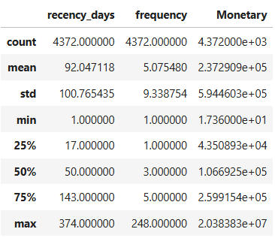
Key Descriptive Statistics Insight Using (Naira) to Analysed
Recency days :On average, customers return every 92 days, but with a large variation (std = 100 days)., minimum recency is 1 day very frequent customers, while the maximum is 374 days, this indicate that the customer have not return for long ,the median (50 days) shows that half of the customers return , while the 75th percentile (143 days) highlights a segment of less frequent customers.
Frequency :On average, customers purchased 5 times, but frequency ranges widely (1 to 248 purchases).25% of customers purchased only once, while 50% purchased 3 times or less,75th percentile (5 purchases) shows that the majority are still low-frequency buyers, with only a small group of highly loyal, frequent shoppers.
Monetary Value :Average spending is about ₦237,000, but the distribution is highly skewed .,the median spending is ₦106,000, while the top 25% spend over ₦260,000.,the maximum spending reaches ₦20.3M, indicating a few very high value customers (clear outliers).,This skewness suggests that while most customers spend moderately, a small group contributes highly to the total revenue.

Slide 12
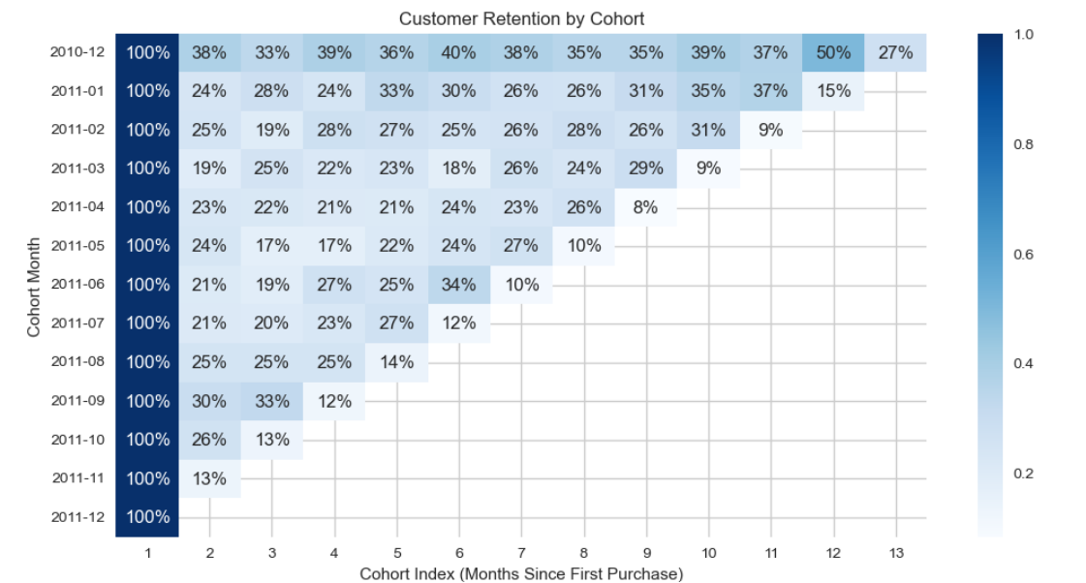
Growth at Entry, Decline Over Time
The business is good at acquiring customers initially but struggles to retain them long-term, Without fixing why they are leaving, in Dec 2010 cohort dominates ,activity across all months and in the following month customer started leave and Majority of customers leave quickly, showing weak customer base

Slide 13
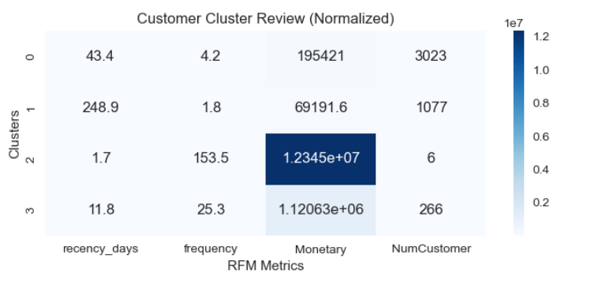
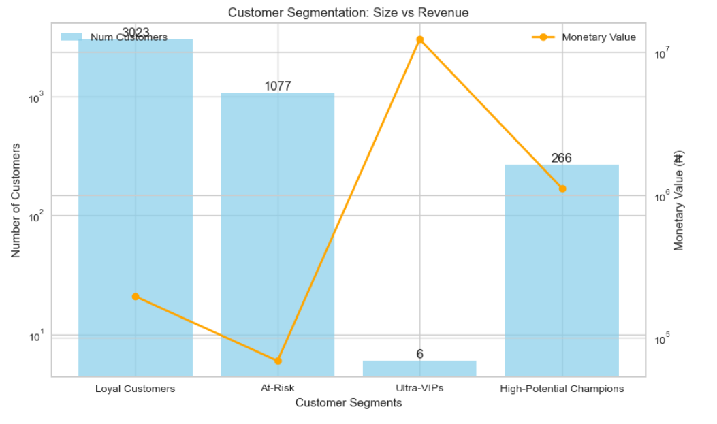
Cluster Analysis (RFM Segmentation)
Customers fall into four groups: Loyal Customers(3,023) with steady purchases, while we are at risk of losing (1,077) showing sign that they may leave, Ultra-VIPs (6) driving outsized revenue, and High-Potential Champions (266) with strong growth potential. Focus should be on retaining VIPs, nurturing Champions, sustaining the Customers, and re-engaging the At-Risk segment.

Slide 14
Business Recommendations
Cross-Selling / Marketing (Cluster 0) : Target with personalized email campaigns or product recommendations also encourage them.
Win-Back Campaign (Cluster 1): Send them an re-engagement emails, discounts, or limited-time offers to analyze why they haven’t purchased recently and adjust offerings accordingly
VIP Engagement (Cluster 2):Offer exclusive rewards, early access to products, personalized services and Focus on retention, because losing a single customer here is very costly.
Retention & Upsell (Cluster 3):Provide loyalty points, bundle offers, or premium product recommendations to also encourage these customers to refer others or increase average order value.
Strategic Outlook
Retain high-value “Clusters 2 & 3” for immediate revenue, grow “Cluster 0” frequency and spend mid-term. Reactivate “Cluster 1” to recover lost revenue. Focus resources on top-performing clusters , while leveraging automated campaigns to engage larger, lower-value segments efficiently.

